Slide 1
ST1508 : PRACTICAL AI
CA1 Assignment
Done by: Jumana Haseen (2021627), Chong Jun Hui (2021094), Tushita Govindaraj (2012155)
DAAA/FT/2B/02

Slide 2
Background Information
Taxi has become a very important part of our lives. Without taxis it would be very hard to get to one place from another efficiently.
According to a research on Evaluating Safety Issues for Taxi Transport Management, 52.5% of taxi drivers have dangerous driving behavior and 46% of these behaviors are done repeatedly.
Purpose: As part of the Data Science team of the Just Taxi company, we would be analysing taxi trip data in order to provide insights in the bigger picture of our company by addressing questions concerning driving safety.

Slide 3
Data Description
The Just Taxi Company has multiple files stored in CSV file – 5 features and 1 labels
Names of files:
Safety_DataSet_features_part-00000-e6120af0-10c2-4248-97c4-81baf4304e5c-c000 → Size: 218,892KB
Safety_DataSet_features_part-00001-e6120af0-10c2-4248-97c4-81baf4304e5c-c000 → Size: 219,766KB
Safety_DataSet_features_part-00002-e6120af0-10c2-4248-97c4-81baf4304e5c-c000 → Size: 220,134KB
Safety_DataSet_features_part-00003-e6120af0-10c2-4248-97c4-81baf4304e5c-c000 → Size: 137,878KB
Safety_DataSet_features_part-00004-e6120af0-10c2-4248-97c4-81baf4304e5c-c000 → Size: 218,758KB
Safety_DataSet_labels_part-00000-e9445087-aa0a-433b-a7f6-7f4c19d78ad6-c000 → Size: 299KB
Features datasets contain information for each trip and statistical data such as accelerometer and gyroscope readings, GPS accuracy and bearing , speed as well as time of record in seconds.
Labels dataset indicated whether a taxi trip is safe or dangerous.

Slide 4
Data Description – Features Table
Total records (5 datasets): 7,469,656
No. | Name | Description | Data Type
1 | featuresID | Identifies each record in column | Int
2 | bookingID | Identifies each trip by taxi | Float
3 | Accuracy | Accuracy inferred by GPS (in metres) | Float
4 | Bearing | GPS bearing (in metres) | Float
5 | acceleration_x | Accelerometer reading at x axis (m/s2) | Float
6 | acceleration_y | Accelerometer reading at y axis (m/s2) | Float
7 | acceleration_z | Accelerometer reading at z axis (m/s2) | Float
8 | gyro_x | Gyroscope reading in x axis (rad/s) | Float
9 | gryo_y | Gyroscope reading in y axis (rad/s) | Float
10 | gryo_z | Gyroscope reading in z axis (rad/s) | Float
11 | second | Time of the record by number of seconds | Float
12 | Speed | Speed measured by GPS in m/s | Float

Slide 5
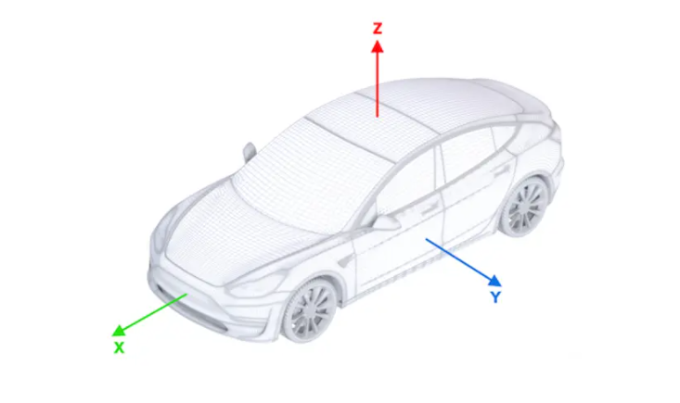
Understanding Accelerometer Readings

Slide 6
Data Description – Features Table
Total records (5 datasets): 7,469,656
No. | Name | Description | Data Type
1 | featuresID | Identifies each record in column | Int
2 | bookingID | Identifies each trip by taxi | Float
3 | Accuracy | Accuracy inferred by GPS (in metres) | Float
4 | Bearing | GPS bearing (in metres) | Float
5 | acceleration_x | Accelerometer reading at x axis (m/s2) | Float
6 | acceleration_y | Accelerometer reading at y axis (m/s2) | Float
7 | acceleration_z | Accelerometer reading at z axis (m/s2) | Float
8 | gyro_x | Gyroscope reading in x axis (rad/s) | Float
9 | gryo_y | Gyroscope reading in y axis (rad/s) | Float
10 | gryo_z | Gyroscope reading in z axis (rad/s) | Float
11 | second | Time of the record by number of seconds | Float
12 | Speed | Speed measured by GPS in m/s | Float

Slide 7
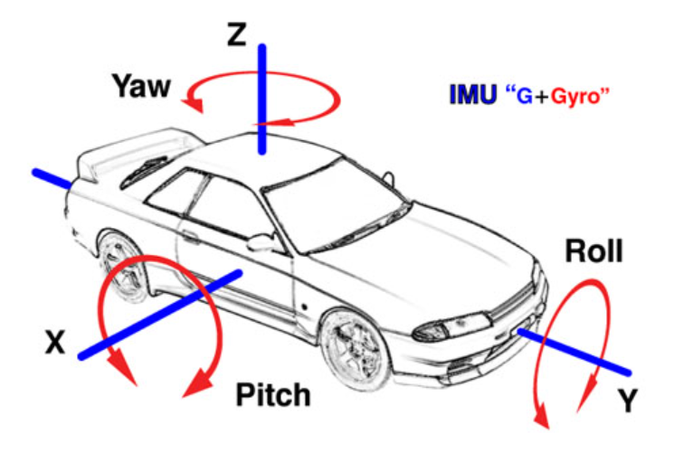
Understanding Gyroscope Readings

Slide 8
Data Description – Labels Table
Total records: 20,018
No. | Name | Description | Data Type
1 | bookingID | Identifies each trip by taxi | Float
2 | label | Indicated whether a trip is safe or dangerous (0 – Safe, 1 – Dangerous) | Int

Slide 9
Data Engineering

Slide 10
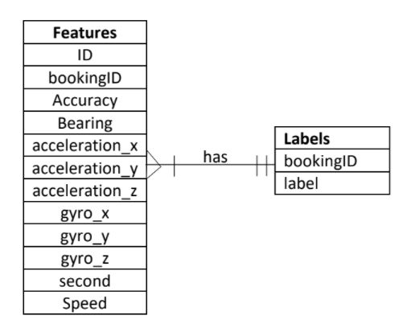
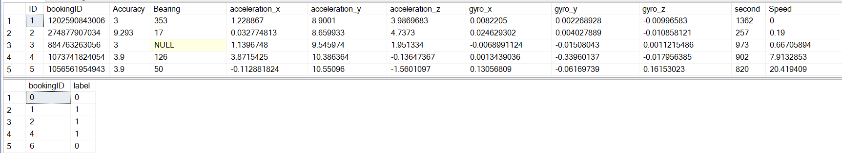
SQL Database Set Up
Merged all the 5 feature tables to make one big table.
Duplicated bookingID records were removed.
ID → Primary key for features table
bookingID → Primary key for labels table
→ Foreign key referenced to bookingID column in features table.
The top 5 records of out final features and labels is shown below.
(19982,2)
(7460914, 12)

Slide 11
Complex Queries

Slide 12
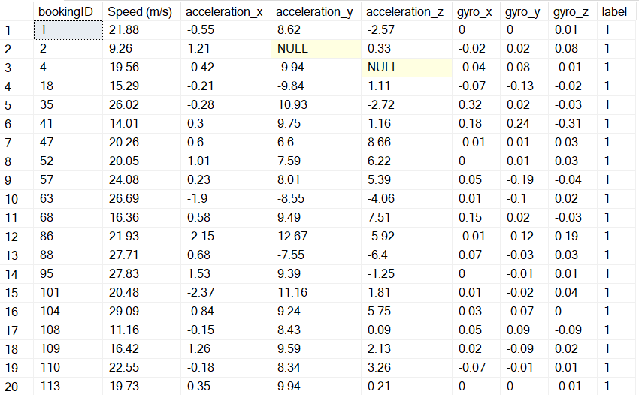
Query 1
SELECT bookingID, ROUND(Speed,2) 'Speed (m/s)', ROUND(acceleration_x,2) 'acceleration_x', ROUND(acceleration_y,2) 'acceleration_y', ROUND(acceleration_z,2) 'acceleration_z', ROUND(gyro_x,2) 'gyro_x', ROUND(gyro_y,2) 'gyro_y', ROUND(gyro_z,2) 'gyro_z', label
FROM(SELECT f.bookingID, Speed, acceleration_x, acceleration_y, acceleration_z, gyro_x, gyro_y, gyro_z, l.label
RANK() OVER (PARTITION BY f.bookingID ORDER BY Speed DESC) AS ranking
FROM features f, labels l
WHERE f.bookingID=l.bookingID AND l.label=1
GROUP BY f.bookingID, Speed, acceleration_x, acceleration_y, acceleration_z, gyro_x, gyro_y, gyro_z, l.label) AS subquery
WHERE subquery.ranking=1
Top 20 records.
Recommendation: Taxi company should consider this changes when classifying a trip as safe or dangerous.
Notes:
Insights: When vehicles speed is highest, acceleration x is always changing but acceleration y and z are generally positive. Thus, vehicles accelerated in the forward and upward direction when speeding up. Gyro reading also keeps fluctuating at high speed.

Slide 13
Query 2
SELECT ROUND(AVG(averageaccuracy),5) as 'average accuracy', ROUND(AVG(averagebearing),5) as 'average bearing', ROUND(AVG(averageacceleration_x),5) as 'average acceleration_x', ROUND(AVG(averageacceleration_y),5) as 'average acceleration_y', ROUND(AVG(averageacceleration_z),5) as 'average acceleration_z', ROUND(AVG(averagegyro_x),5) as 'average gyro_x', ROUND(AVG(averagegyro_y),5) as 'average gyro_y', ROUND(AVG(averagegyro_z),5) as 'average gyro_z', ROUND(AVG(averagespeed),5) as 'average speed', subquery1.label FROM (
SELECT c.bookingID, AVG(Accuracy) as 'averageaccuracy', AVG(Bearing) as 'averagebearing', AVG(acceleration_x) as 'averageacceleration_x', AVG(acceleration_y) as 'averageacceleration_y', AVG(acceleration_z) as 'averageacceleration_z', AVG(gyro_x) as 'averagegyro_x', AVG(gyro_y) as 'averagegyro_y', AVG(gyro_z) as 'averagegyro_z', AVG(speed) as 'averagespeed', c.label
FROM features f INNER JOIN (SELECT e1.bookingID, e1.label FROM labels e1
INNER JOIN (SELECT e3.bookingID FROM labels e3 GROUP BY e3.bookingID HAVING COUNT(e3.bookingID) = 1) e2 ON e1.bookingID = e2.bookingID) c ON f.bookingID = c.bookingID GROUP BY c.bookingID, c.label) subquery1 GROUP BY subquery1.label
Recommendation: Taxi company managers could use these values as the boundary/ limit for vehicles to follow so that passengers can have a safe trip.

Slide 14
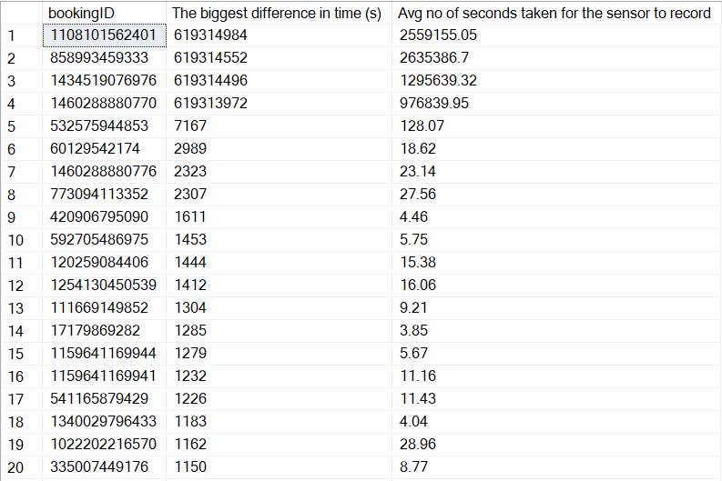
Query 3
SELECT subquery1.bookingID, [The biggest difference in time (s)], [Avg no of seconds taken for the sensor to record] FROM
(SELECT difft.bookingID, max(difft.diff) AS 'The biggest difference in time (s)' FROM
(SELECT bookingID, second, second - lag(second, 1) OVER (PARTITION BY bookingid ORDER BY second) AS diff FROM features) difft
GROUP BY difft.bookingID) AS subquery1,
(SELECT difft.bookingID, ROUND(AVG(difft.diff) OVER(PARTITION BY difft.bookingID),2) AS 'Avg no of seconds taken for the sensor to record' FROM (SELECT bookingID, second, second - lag(second, 1) OVER (PARTITION BY bookingid ORDER BY second) AS diff FROM features) difft) AS subquery2
WHERE subquery1.bookingID=subquery2.bookingID
GROUP BY subquery1.bookingID, subquery1.[The biggest difference in time (s)], subquery2.[Avg no of seconds taken for the sensor to record]
ORDER BY 2 DESC
Recommendation: Taxi company should get a better sensor so that the sensor can record down more records to get a better understanding of the trips and lead to better accuracy to the result of the bookingID.

Slide 15
ETL Process

Slide 16
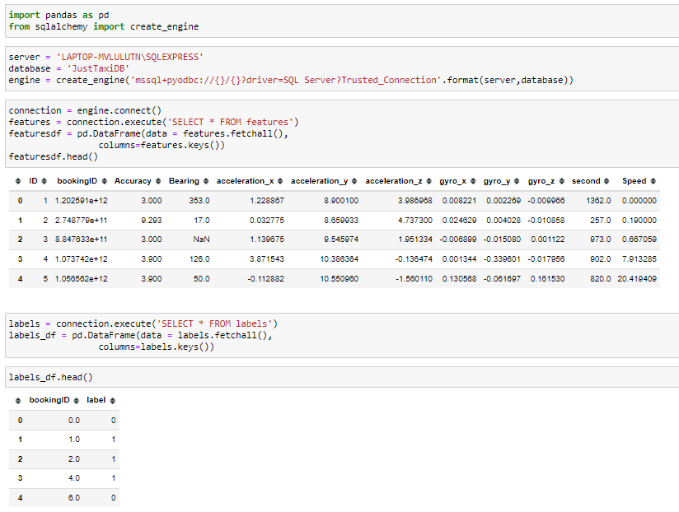
ETL Pipeline - Extract

Slide 17
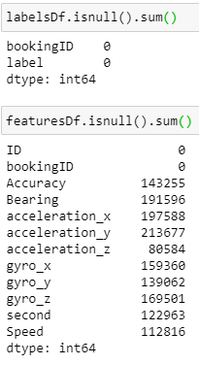
ETL Pipeline - Transform
Labels data did not have anything to be cleaned. Did not have any null values.
Features data has quite a number of null values present and hence, they are needed to be managed.
Outliers were also needed to be examined and handled so that final data is as accurate as possible.

Slide 18
Data Cleansing

Slide 19
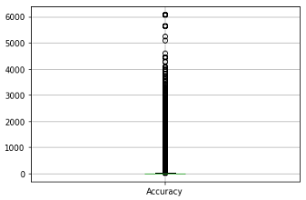
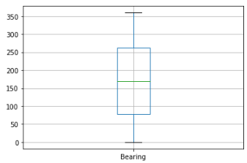
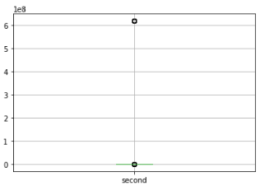
Handling Outliers
Accuracy
Too many irregular values above 1500. Records with above 1500 accuracy were removed. (4726 records)
Bearing
The boxplot shows normal distribution and all values were within 0 and 359. No values removed.
Second
Outlier values were all the same above 6,000,000 seconds. Values above that were removed. (37 records)

Slide 20
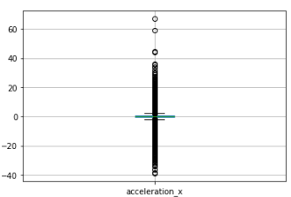
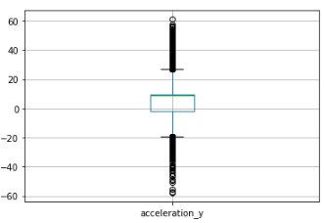
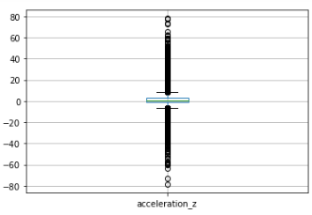
Handling Outliers
Acceleration x
Values not between -10 and 10m/s2 were removed.
(8097 records)
Acceleration y
Values not between -20 and 25m/s were removed.
(7040 records)
Acceleration z
Values not between -15 and 915m/s2 were removed.
(6760 records)

Slide 21
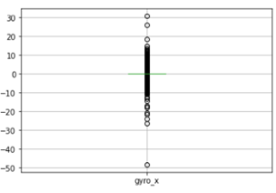
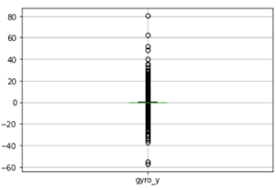
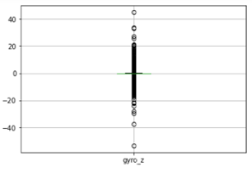
Handling Outliers
Gyro x
Values not between -1 and 1 rad/s were removed.
(17265 records)
Gyro y
Values not between -6 and 6 rad/s were removed.
(3380 records)
Gyro z
Values not between -7 and 7 rad/s were removed.
(215 records)

Slide 22
Handling Null Values
No outliers were removed for the speed column since extreme values are crucial to determine whether a taxi trip is safe or dangerous. Thus, we proceeded to handle the null values.
The large dataset was split by booking ID into 3 subsets and each member in the team took 1 set to handle the null values. (More efficient and faster)
Accuracy: Null values were replaced with mode.
Bearing: Null values were replaced with 0.
Speed, acceleration and Gyro: Null values were replaced with median, based on the records before and after each null value. For consecutive null values, SD was found for each booking ID and subsequently added to the SD following up to the null values. For booking IDs that contained only null values or less than 5 records for each column, they were dropped.
Seconds: Since replacing null values with mean, median, mode, 0, backfill or forward fill did not seem appropriate, removed all the null records.

Slide 23
ETL Pipeline - Load
After thoroughly cleaning the dataset to high accuracy as much as possible, the final features dataset has 7,194,253 records and 11 columns.
96% of the original 7,469,656 records were retained.
All 3 sets of cleaned data were concatenated to form the final dataset and loaded it to CSV file named ‘final_features.csv’.
Label column from the labels table was then merged to the final features table by bookingID and the new table was loaded to a CSV file named ‘JustTaxi.csv’.

Slide 24
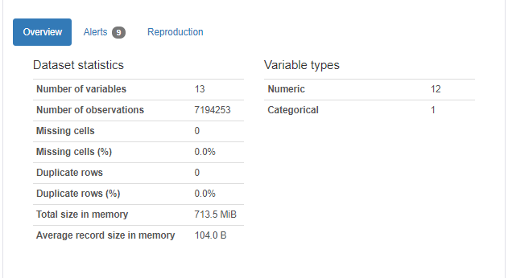
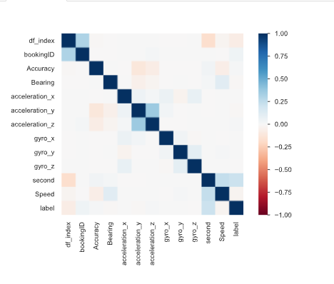
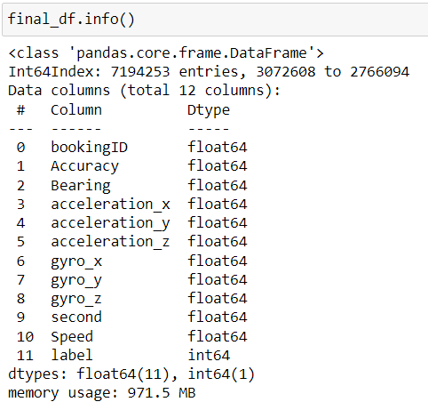
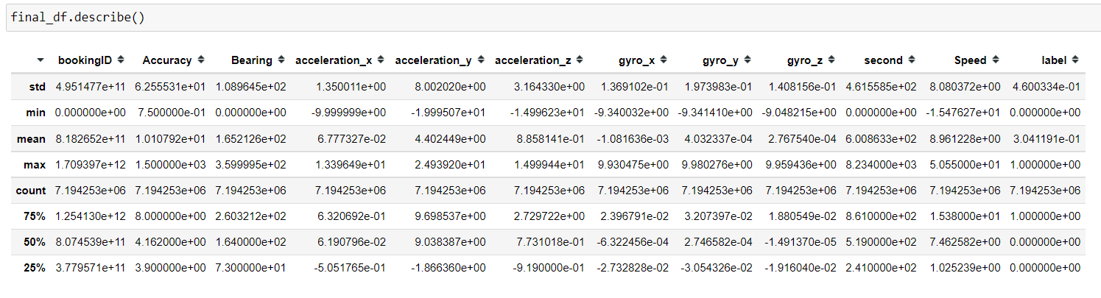
Final Dataset

Slide 25
Data Visualization

Slide 26
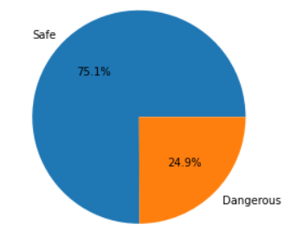
Overview
Pie chart was done to visualize the percentage of safe and dangerous trips in dataset.
Safe: 75.1%
Dangerous: 24.9%
Almost 1 quarter of taxi trips were dangerous, which is not good.
Company need to reduce percentage of dangerous trips to gain trust from customers.

Slide 27
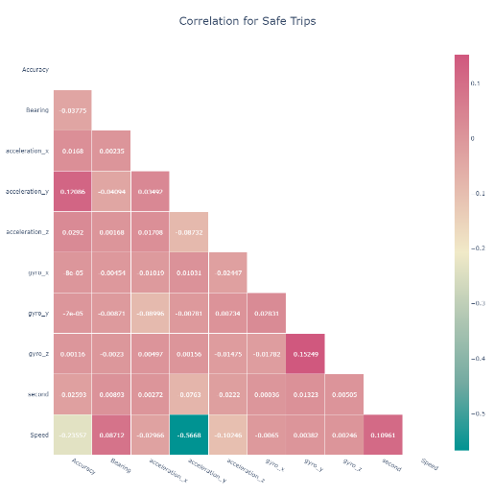
Correlation Between All Features – Safe Trips
Correlation heatmap was done to visualize the correlation between all features for safe trips. Done for records with accuracy within 3.
Generally, correlation is low.
Highest correlation between speed and acceleration y (0.121).
Lowest correlation between second and gyro z (0.00036).
Highest negative correlation between speed and acceleration x (-0.567).

Slide 28
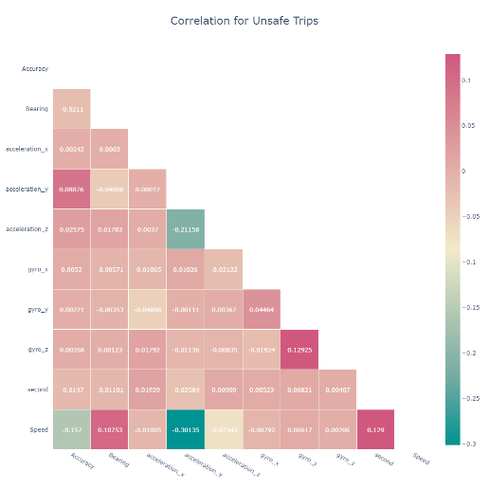
Correlation Between All Features – Dangerous Trips
Correlation heatmap was done to visualize the correlation between all features for dangerous trips. Done for records with accuracy within 3.
Generally, correlation is low.
Highest correlation between speed and second (0.129).
Lowest correlation between acceleration y and acceleration x (0.00012).
Highest negative correlation between speed and acceleration y (-0.301).

Slide 29
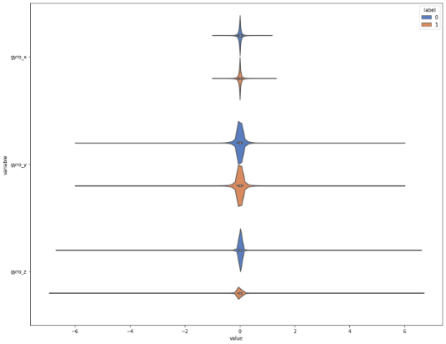
Distribution Of Gyroscope Readings
Violin plot was done to compare the distribution of gyro values for safe and dangerous trips.
Gyro_x has the highest range (-1 to 1.5), followed by gyro_y (-6 to 6) then gyro_z (-7 to 7).
Median for all gyro seem to be same, close to 0.
Gyro_x and gyro_y do not have much difference when comparing safe and dangerous trips.
Gyro_z has higher range and a smaller percentage of values are close to 0 for dangerous trips than for safe trips.

Slide 30
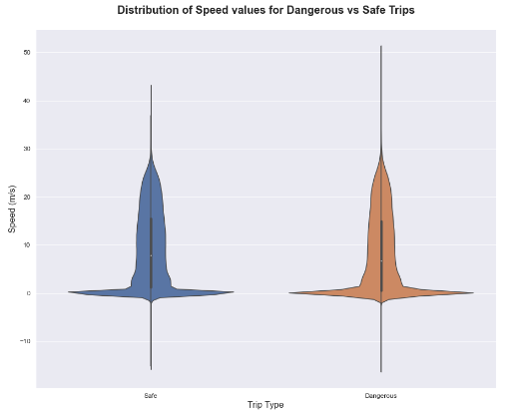
Distribution Of Speed
Violin plot to compare the distribution of speed for safe and dangerous taxi trips.
Range of speed for dangerous trips is larger (-18 to 51 m/s) than that for safe trips (-18 to 42 m/s).
Safe trips have slightly higher median of 19m/s than that for dangerous trips which is 18m/s.
Interquartile range seem to be similar for both.

Slide 31
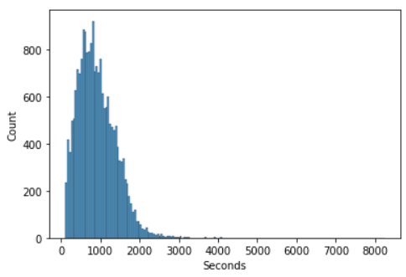
Distribution Of Time
Histogram to analyse the distribution of seconds to find the overall period of time for taxi trips.
The graph is positively skewed with most trips lasting between 500 to 1500s. (8-25min).
Very few trips lasts up to 8000s which is slightly more than 2 hours.

Slide 32
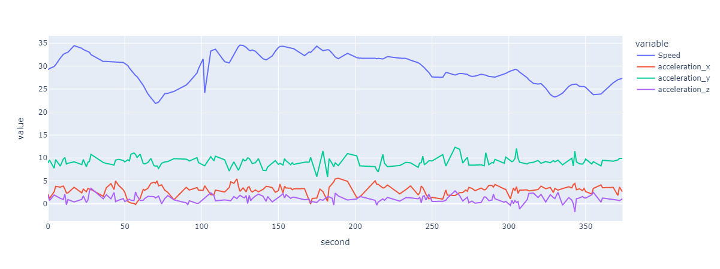
Analysis Based on Speed and Accelerometer Readings
Line chart done for bookingID with overall median speed to see and compare the changes in speed and accelerations over time.
Values of acceleration y is the highest, followed by acceleration x then acceleration z.
Changes in speed do not have much impact on acceleration generally. (e.g. at 100s, speed had a sudden drop but acceleration only had a slight drop.)

Slide 33
Tableau Dashboard

Slide 34
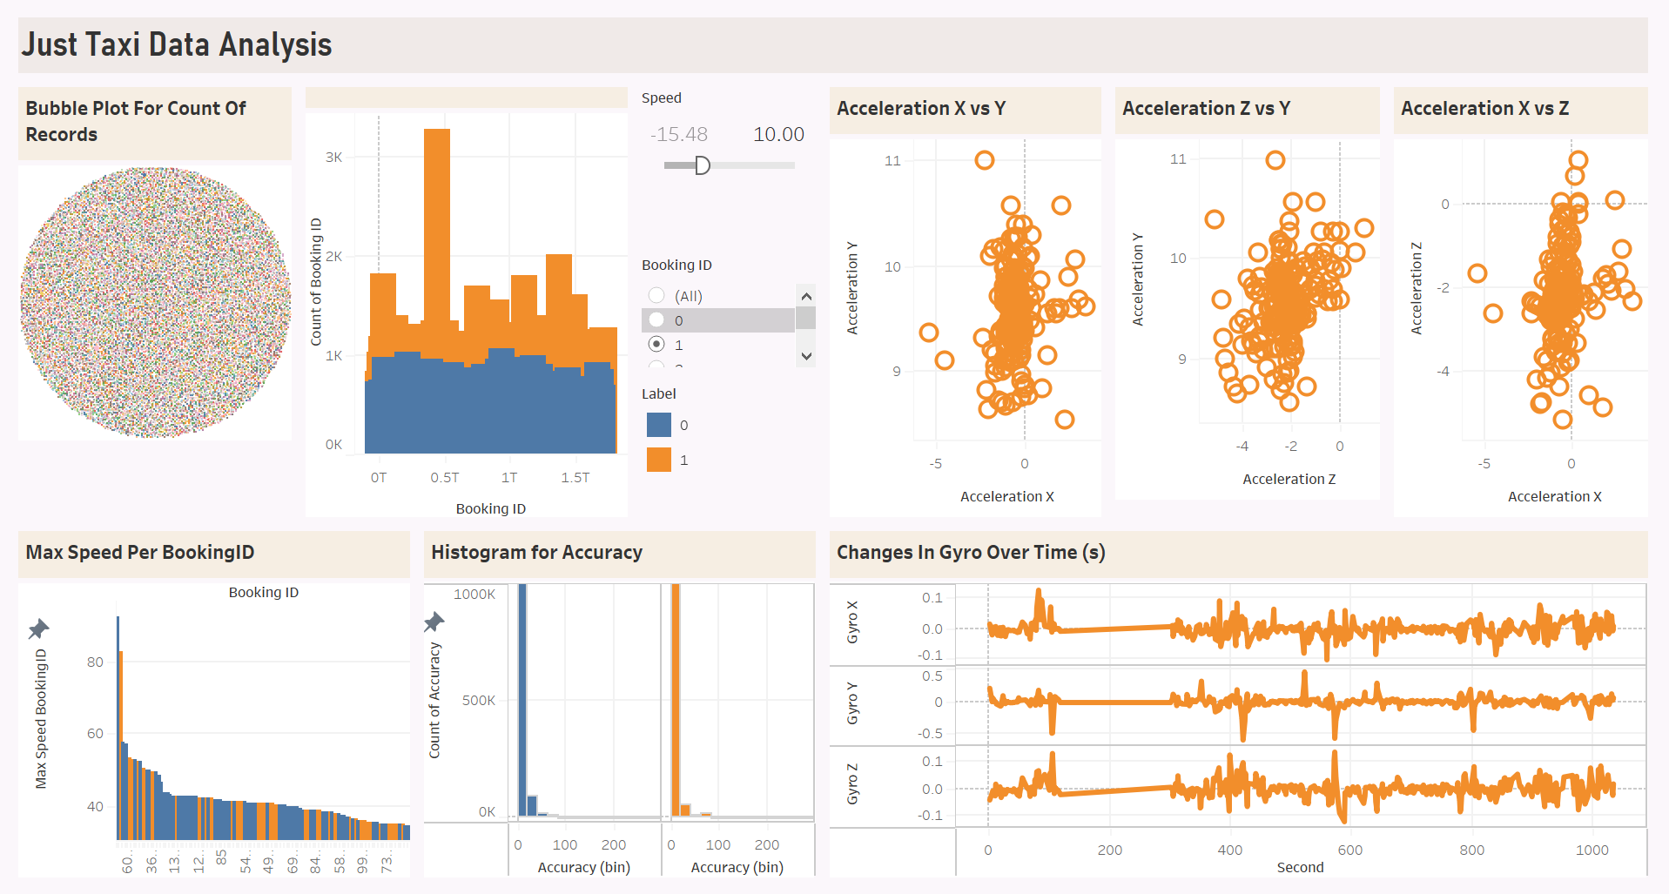
ANALYSIS
INSIGHTS

Slide 35
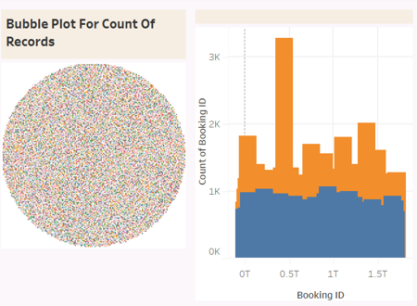
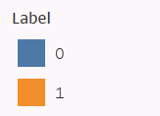
Packed Bubble Plot
Bubble plot was done to see if the number of records for each bookingID varies a lot.
Number of bookingIDs is somewhat equal for all the bookingIDs, no significant difference.
The bar plot however, shows the number of records for bookingIDs of dangerous trips is generally higher than that for safe trips.
Since overall number of safe trips is higher than number of dangerous trips, dataset do not seem to be biased.

Slide 36
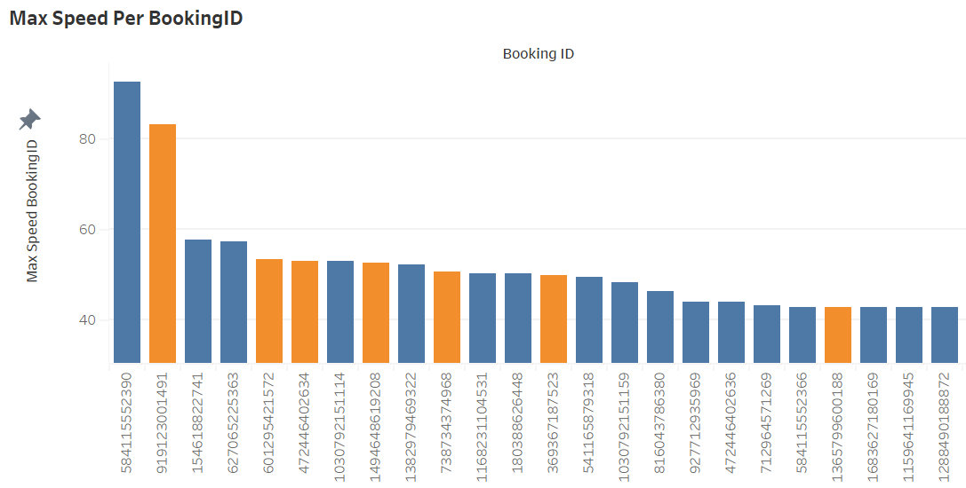
Bar Chart
Max Speed for each bookingID was found and plotted in descending order.
There are many bookingIDs of safe trips with high speed.
This could mean that the taxis in the company are working efficiently since they can bring passengers home safely and quickly.

Slide 37
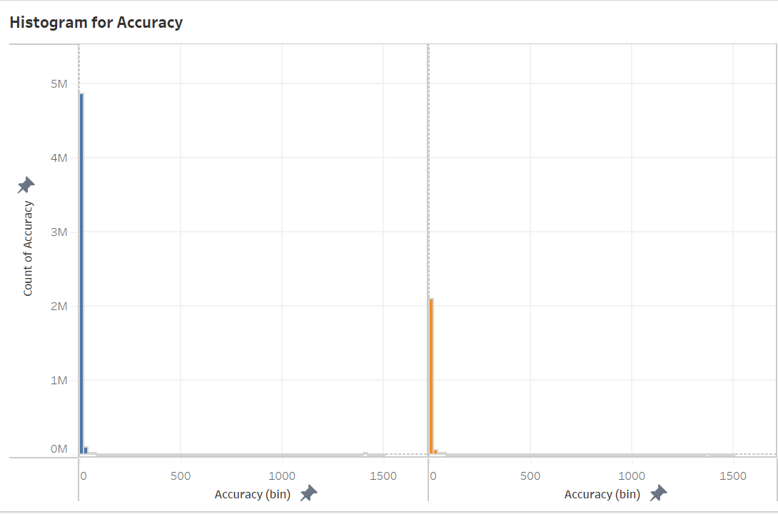
Histogram
Histogram to visualize the accuracy of GPS for safe and dangerous trips.
Compared to dangerous trips, safe trips have higher number of records with lower values.
This is expected since the lower the accuracy of GPS, the better.

Slide 38
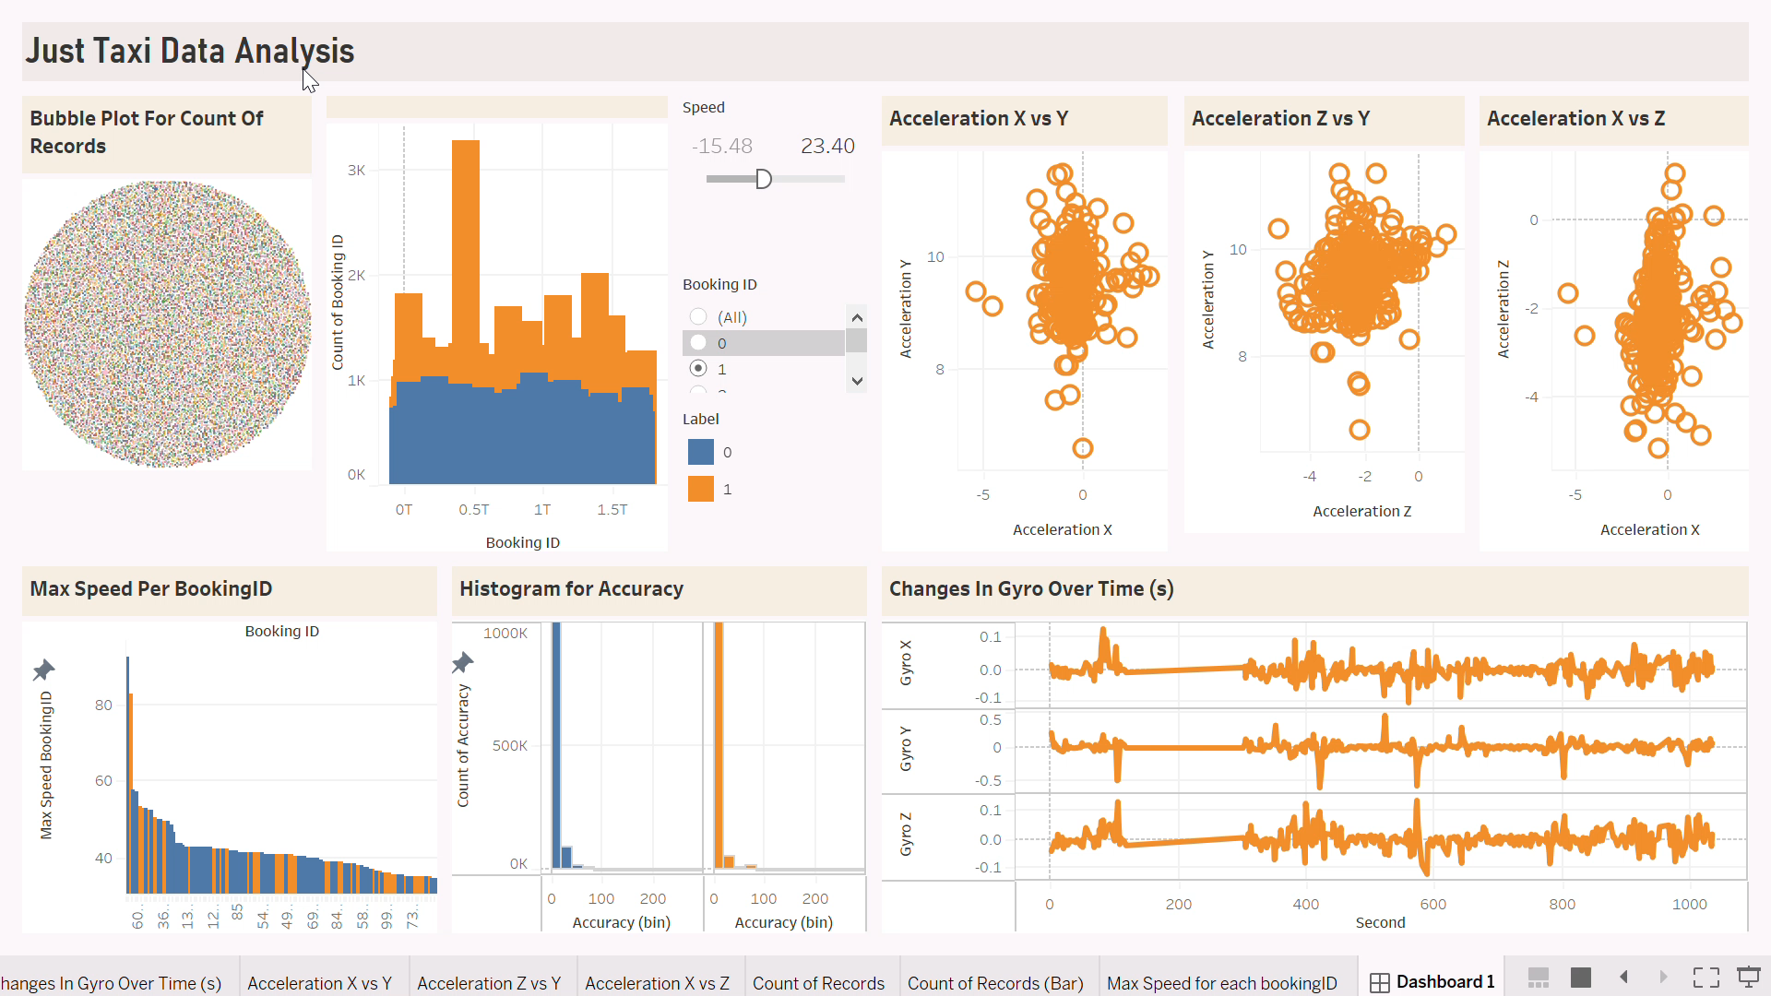
Dashboard Analysis

Slide 39

Dashboard Analysis

Slide 40
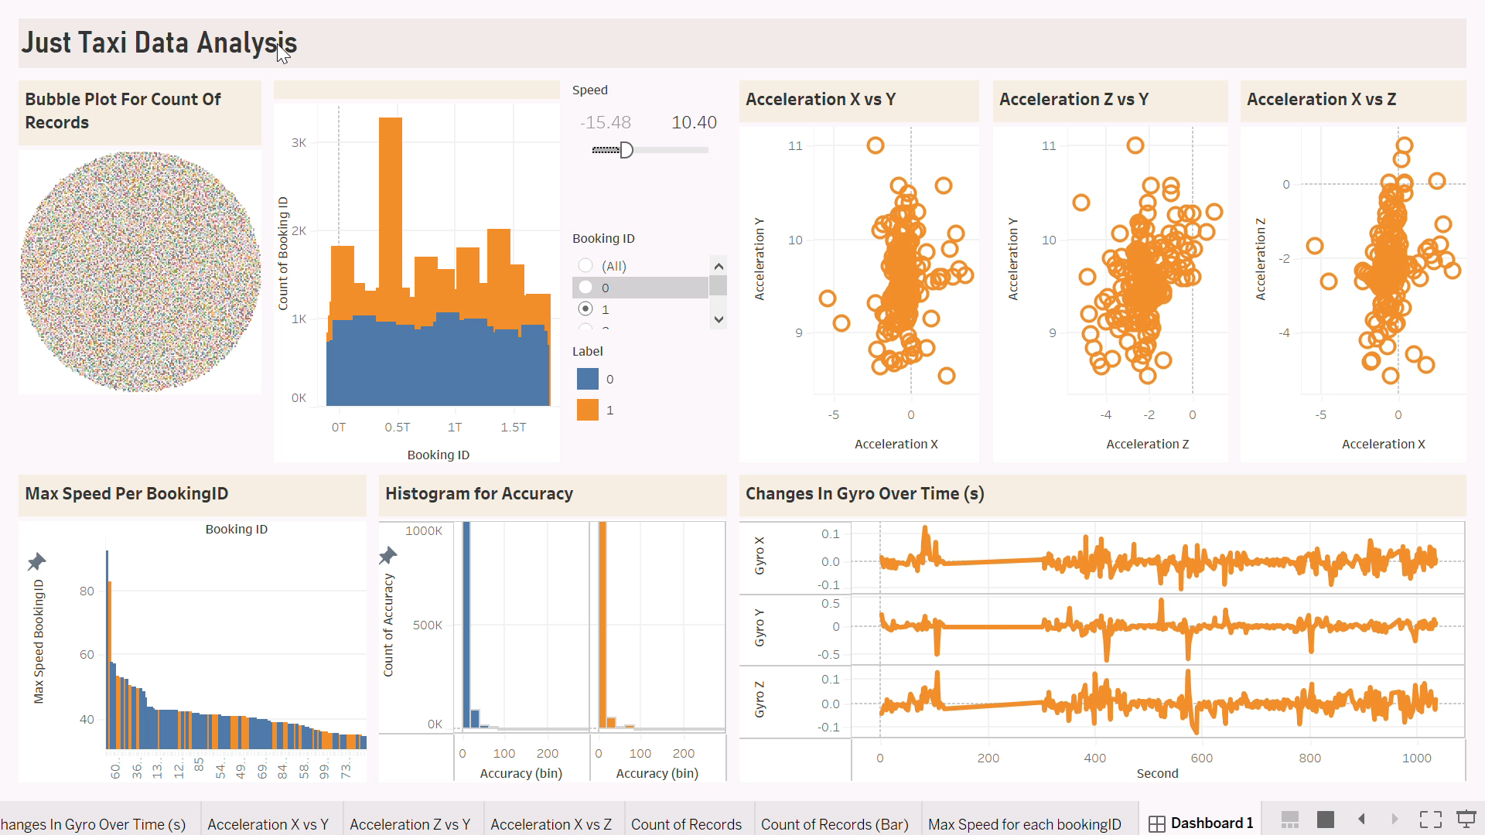
Dashboard Analysis

Slide 41
THE END

